Slide 1



Reduction Algorithms for Persistence Diagrams of Networks: CoralTDA and PrunIT
Cuneyt Akcora, Yulia R. Gel, Murat Kantarcioglu, Baris Coskunuzer
NeurIPS | 2022 Thirty-sixth Conference on Neural Information Processing Systems

Slide 2
Topological data analysis (TDA) delivers invaluable and complementary information on the intrinsic properties of data inaccessible to conventional methods.
Persistent Homology is a unique feature extraction method in graph learning tasks.

Slide 3
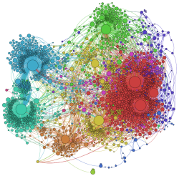
However, high computational costs remain the primary roadblock hindering the successful application of TDA in real-world studies, particularly with machine learning on large complex networks.
Image: https://www.mkbergman.com/968/a-new-best-friend-gephi-for-large-scale-networks/

Slide 4
We provide two algorithms to reduce the graph size significantly without changing the persistent homology output:
CoralTDA: core decomposition-based
PrunIt: domination-based

Slide 5
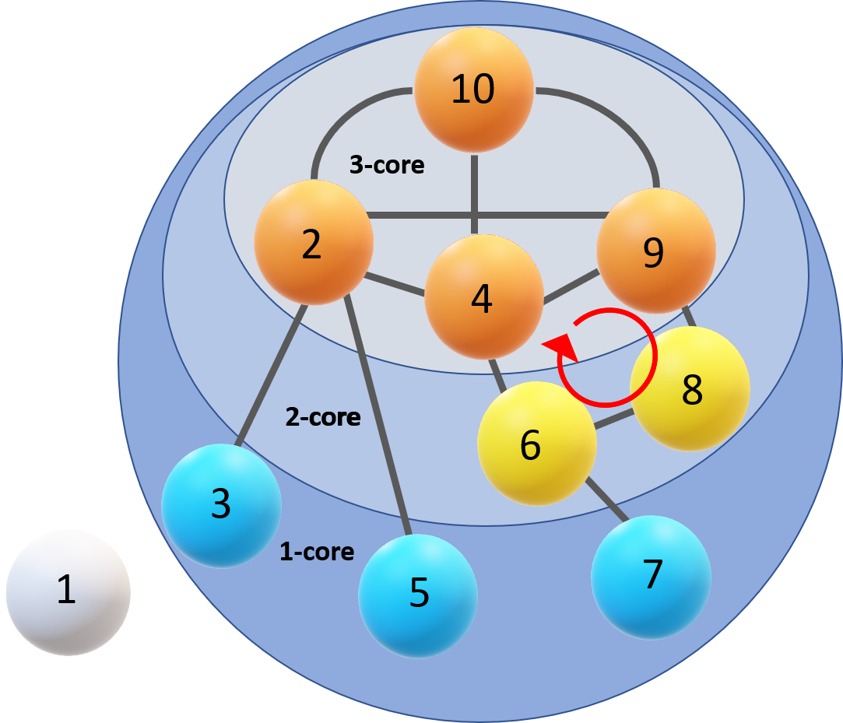
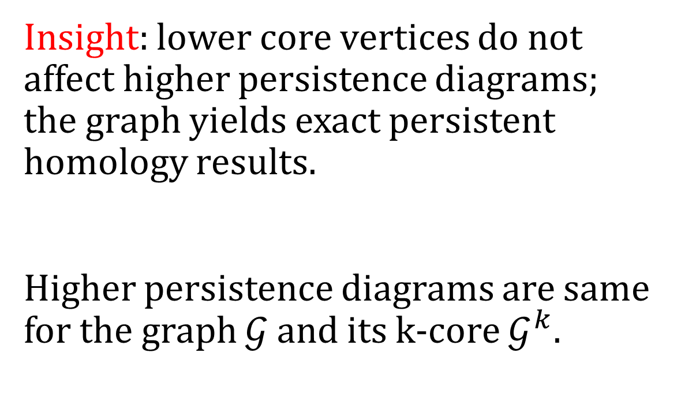
CoralTDA
Insight: lower core vertices do not affect higher persistence diagrams; the graph yields exact persistent homology results.
Higher persistence diagrams are same for the graph $𝒢$ and its k-core $𝒢^{k}.$
Vertices 1, 3, 5 and 7 cannot create 1-dimensional holes

Slide 6
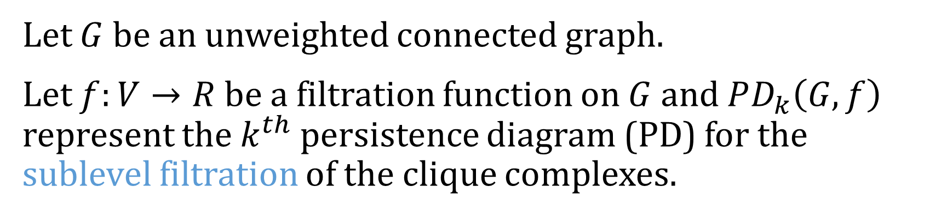
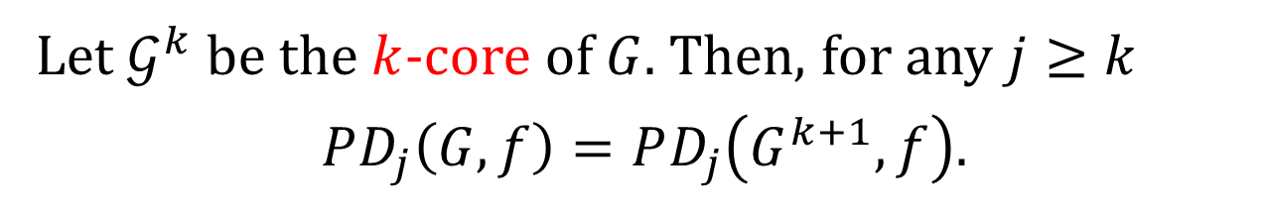
CoralTDA
Let $G$ be an unweighted connected graph.
Let $f:V→R$ be a filtration function on $G$ and $PD_{k}\left(G,f\right)$ represent the $k^{th}$ persistence diagram (PD) for the sublevel filtration of the clique complexes.
Let $𝒢^{k}$ be the $k$-core of $G$. Then, for any $j≥k$
$$PD_{j}\left(G,f\right)=PD_{j}\left(G^{k+1},f\right).$$
K-core of $G$, $G^{k}$, is the largest subgraph of $G$ where all the vertices have a degree of at least $k$.

Slide 7
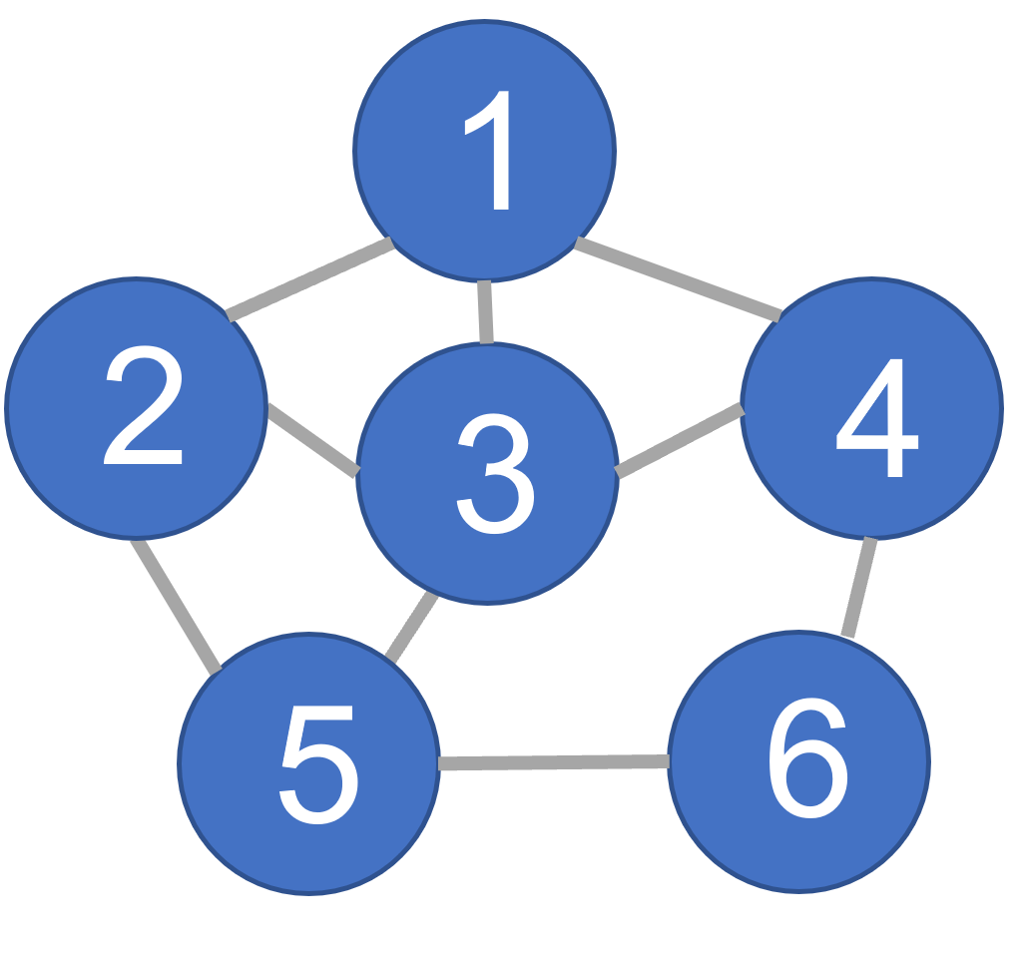
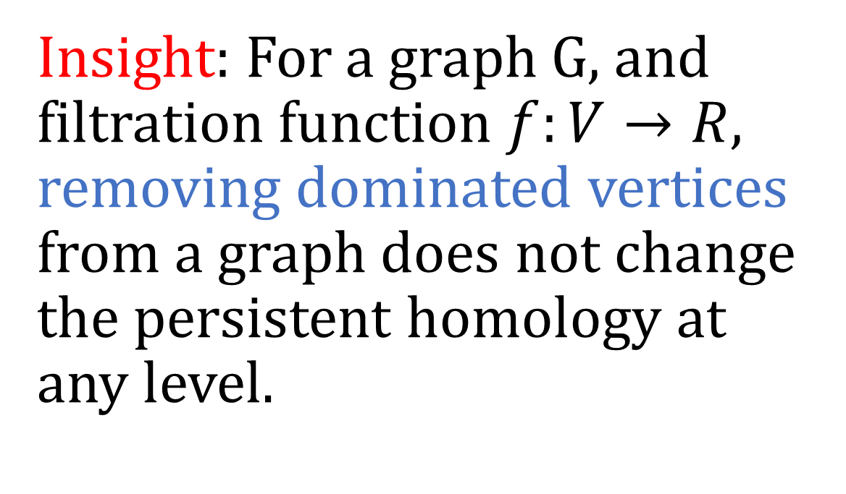
PrunIT
Insight: For a graph G, and filtration function $f:V→R$, removing dominated vertices from a graph does not change the persistent homology at any level.
Vertex 3 dominates vertices 1 and 2. There are no other dominated vertices.

Slide 8
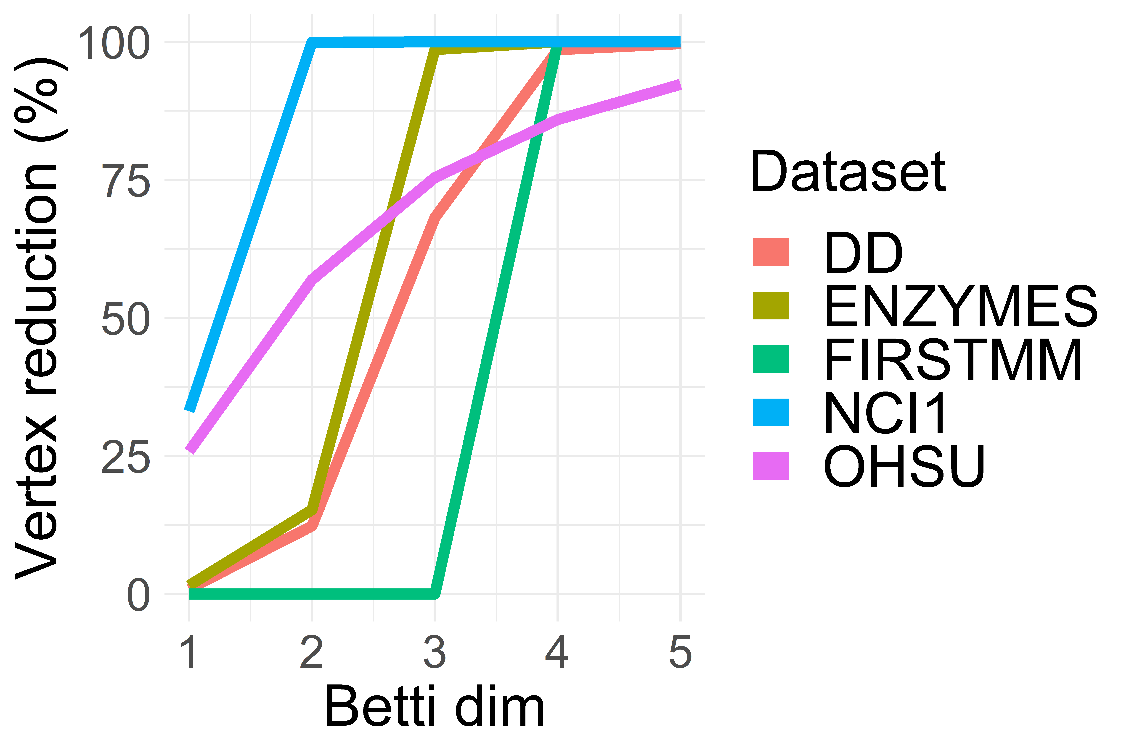
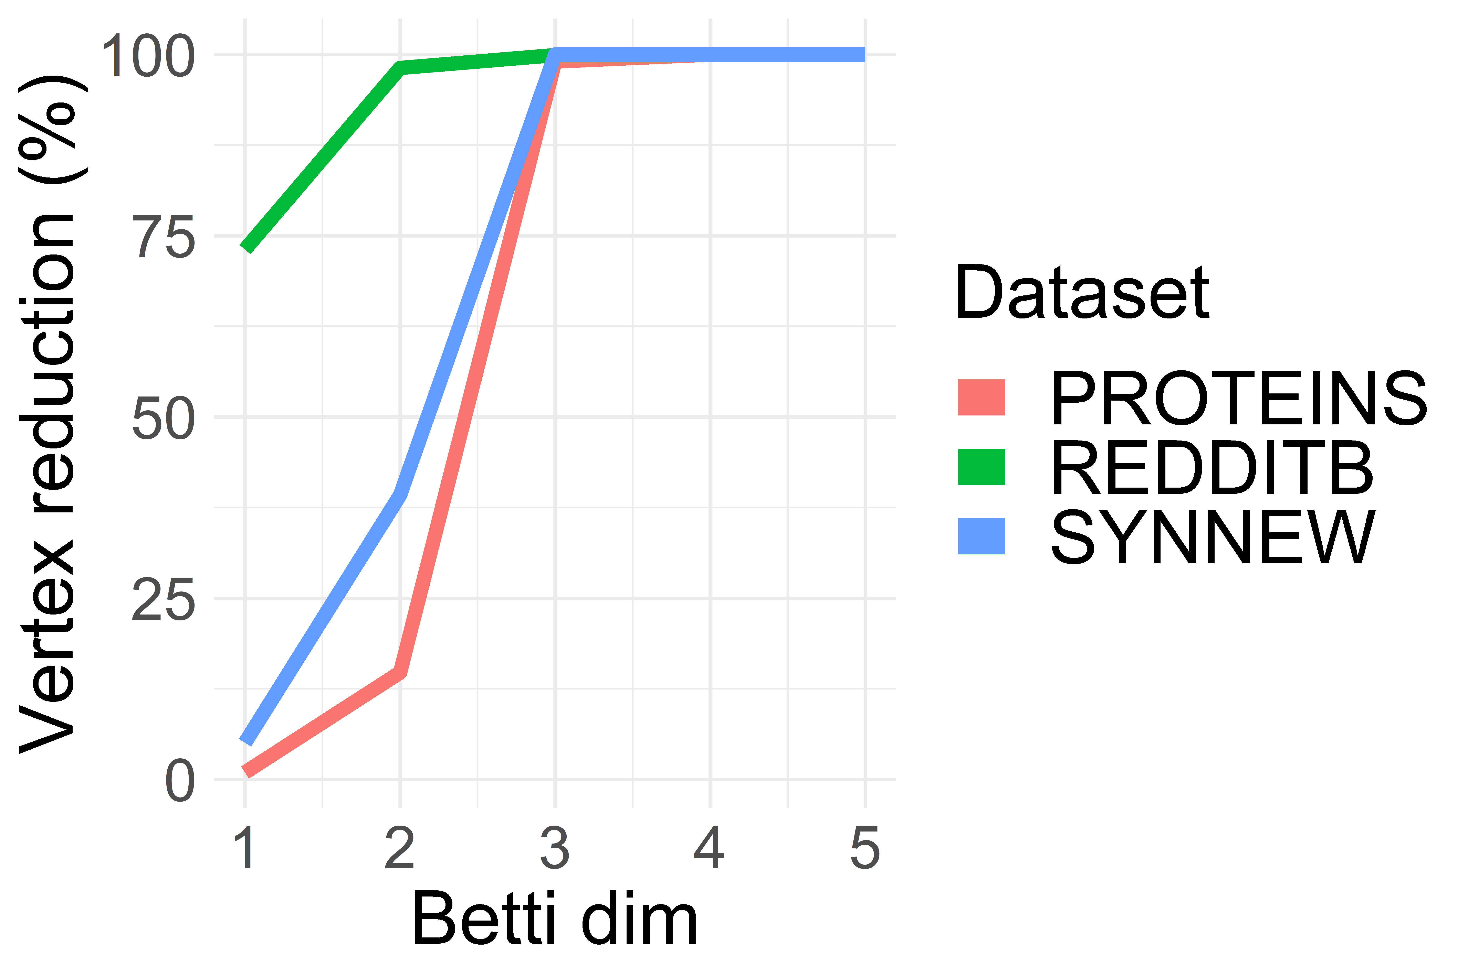
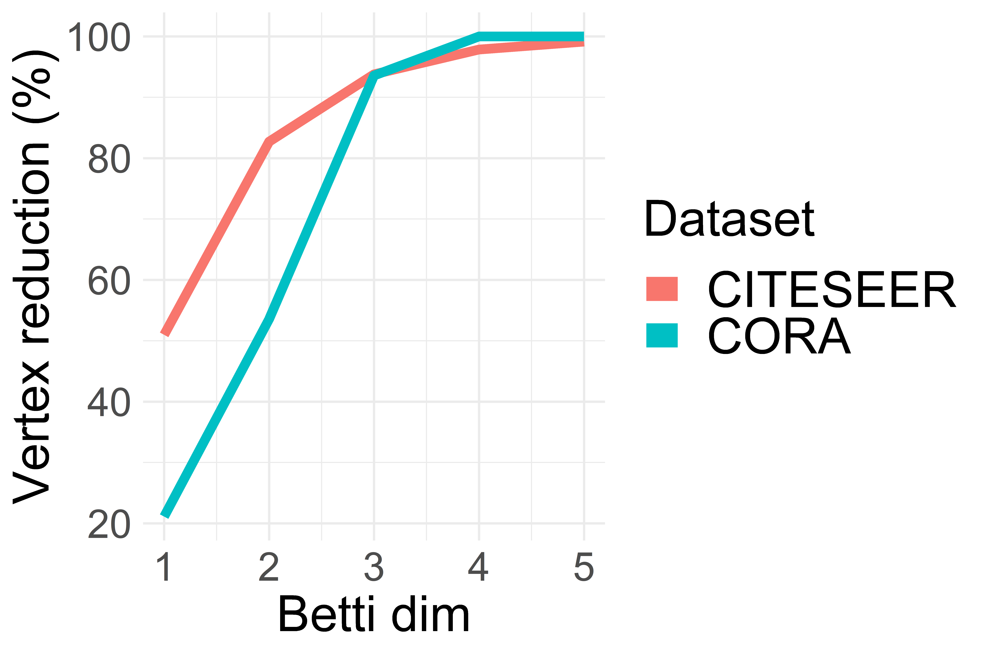
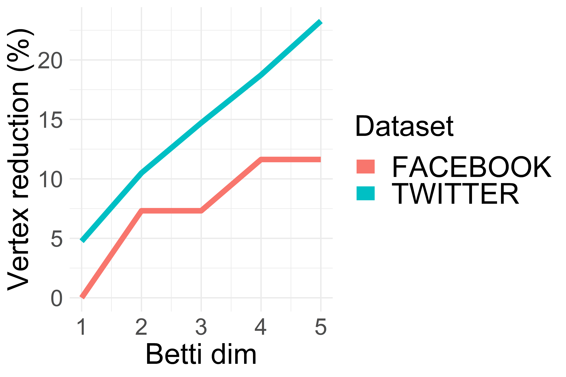
CoralTDA Results on Graph and Node Classification Datasets
FACEBOOK and TWITTER datasets are reduced by 20% for k > 4, whereas in other datasets graphs are reduced to empty sets.

Slide 9
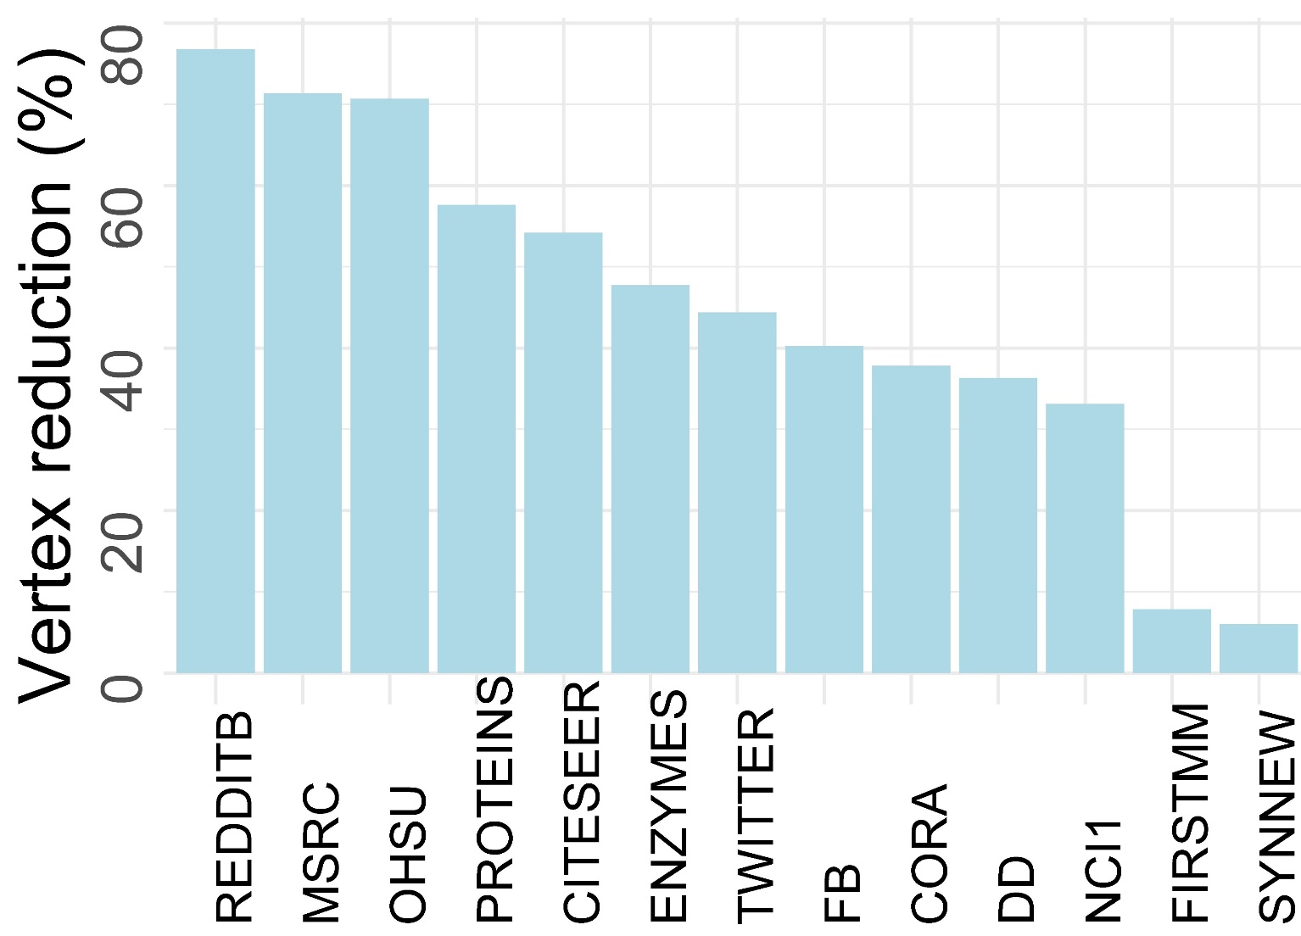
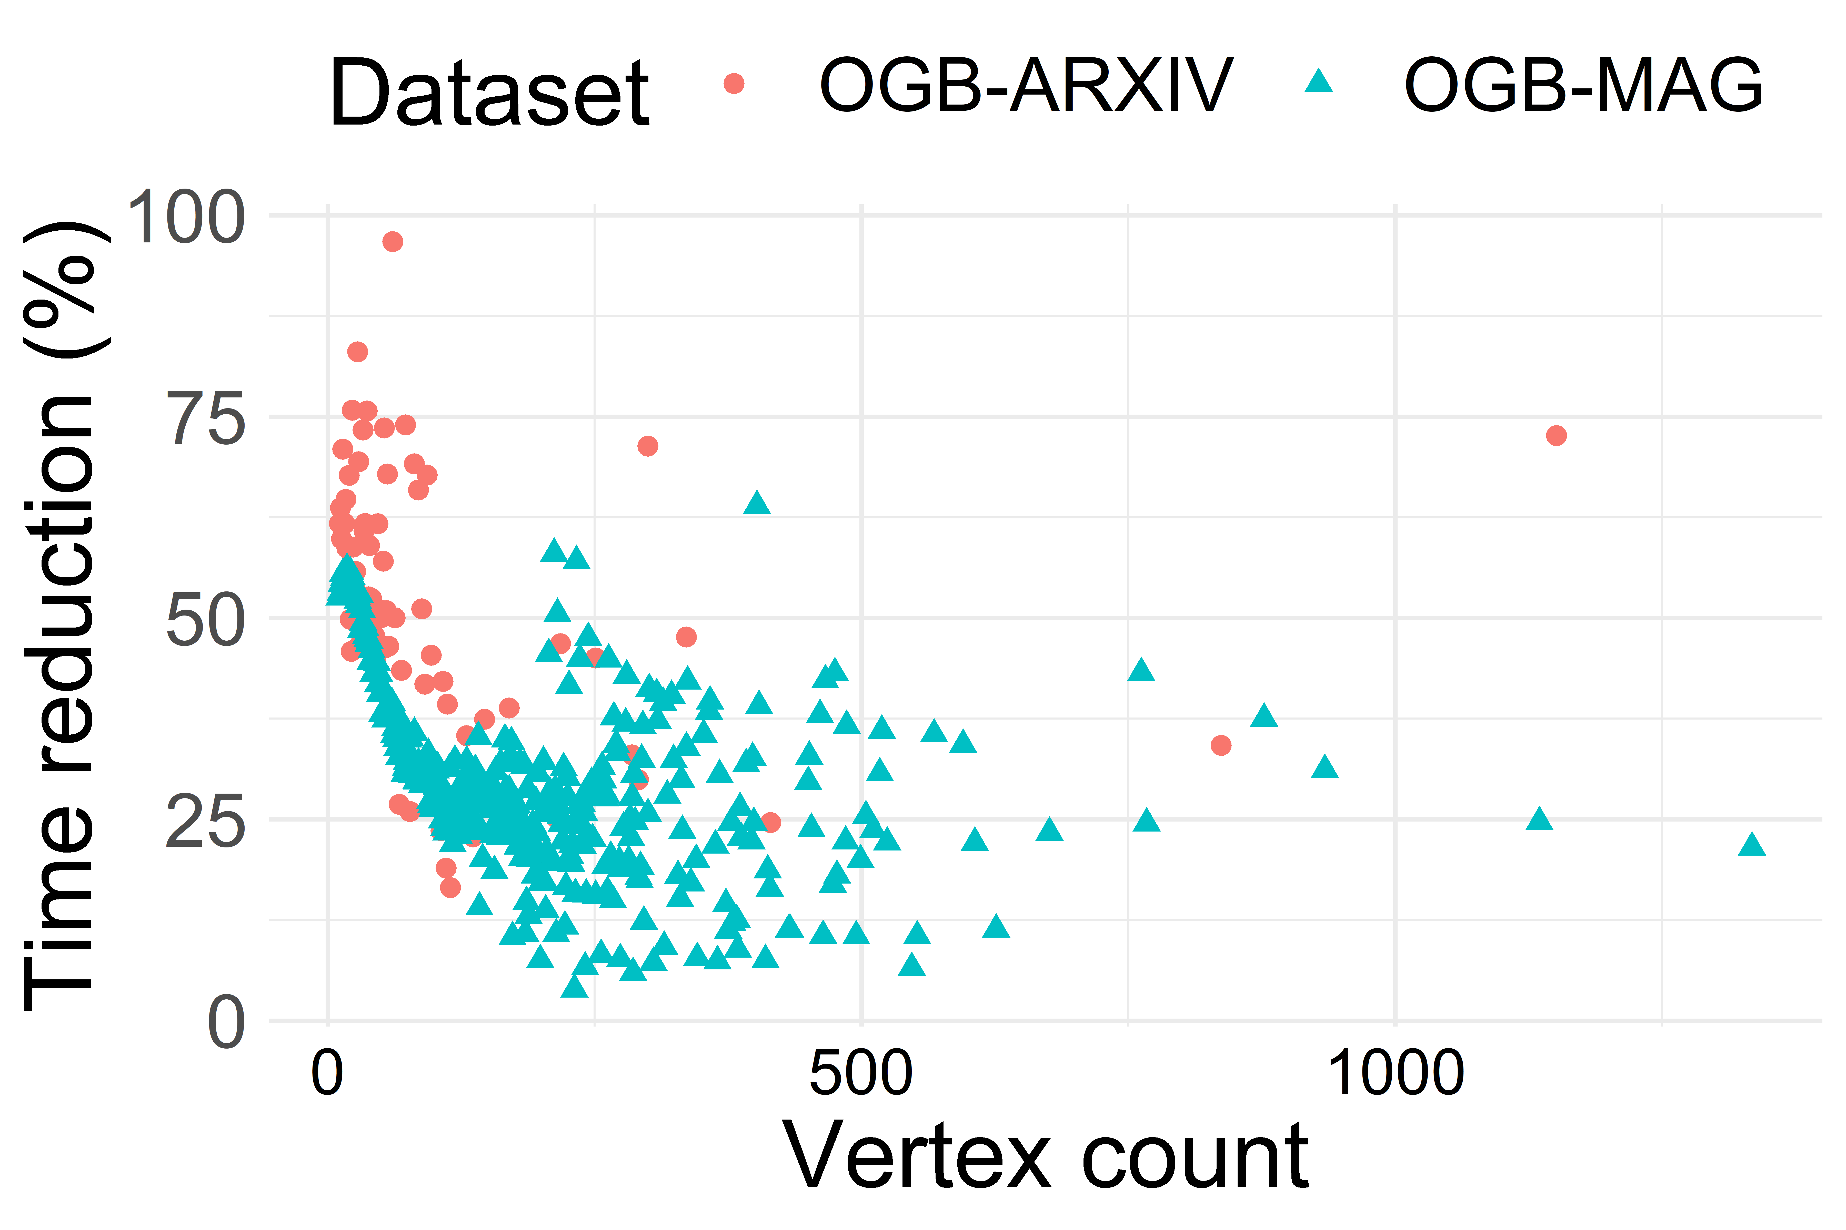
PrunIT Results on Graph and Node Classification Datasets
Vertex reduction by PrunIT algorithm.
Results are averages of graph instances from the datasets. Filtration function is vertex degree.
PrunIT reduction in OGB node classification dataset.
Each data point is an ego network.
Even for large networks, time reduction rates can reach 75%.

Slide 10
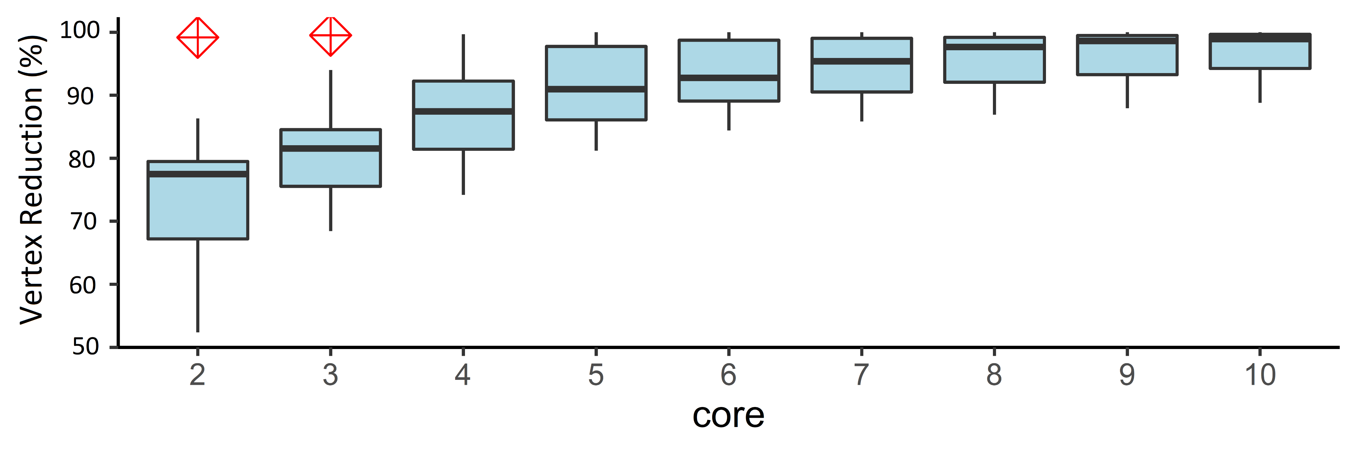
Combining CoralTDA and PrunIT
Vertex reduction results for 11 large datasets after the application of PrunIt and CoralTDA algorithms.
(the largest graph: youtube.com, has 1.1M vertices)
emailEuAll is the outlier for the 2nd and 3rd cores (shown with a crossed square).

Slide 11
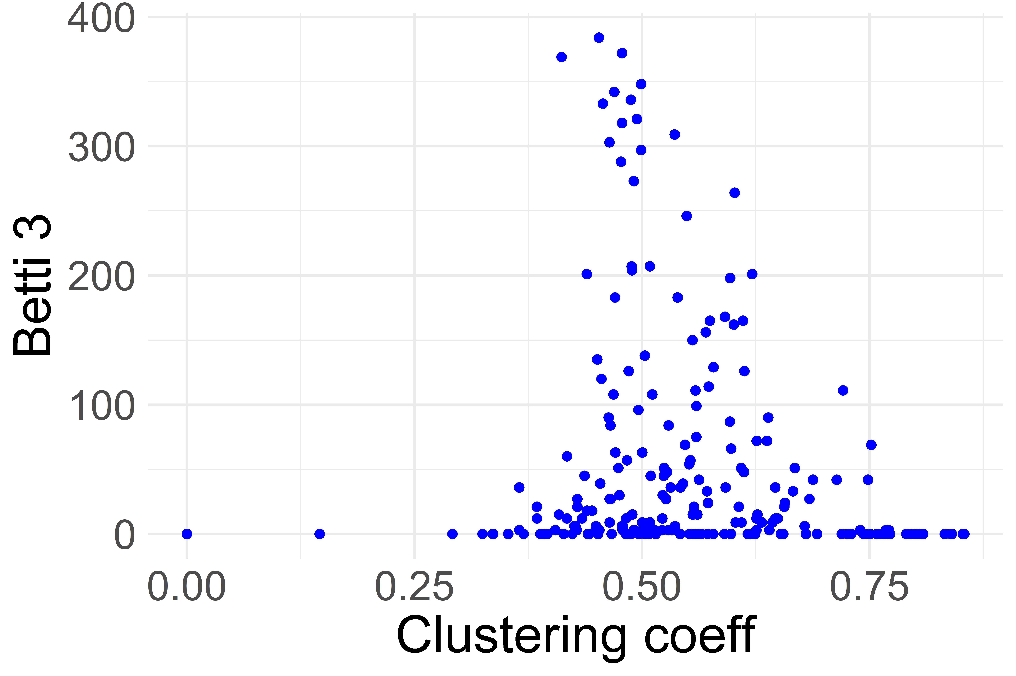
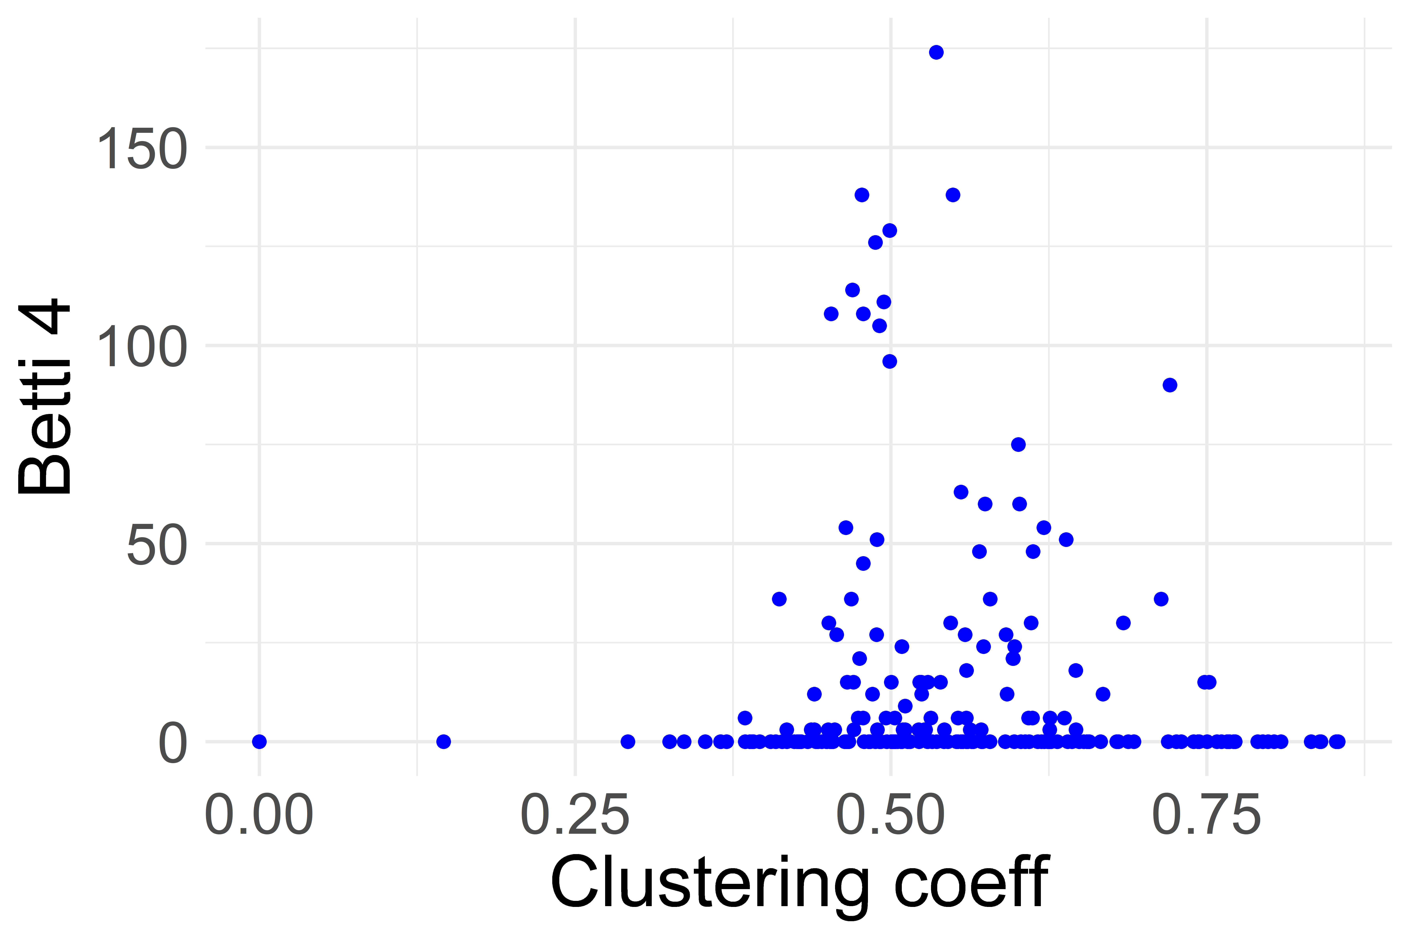
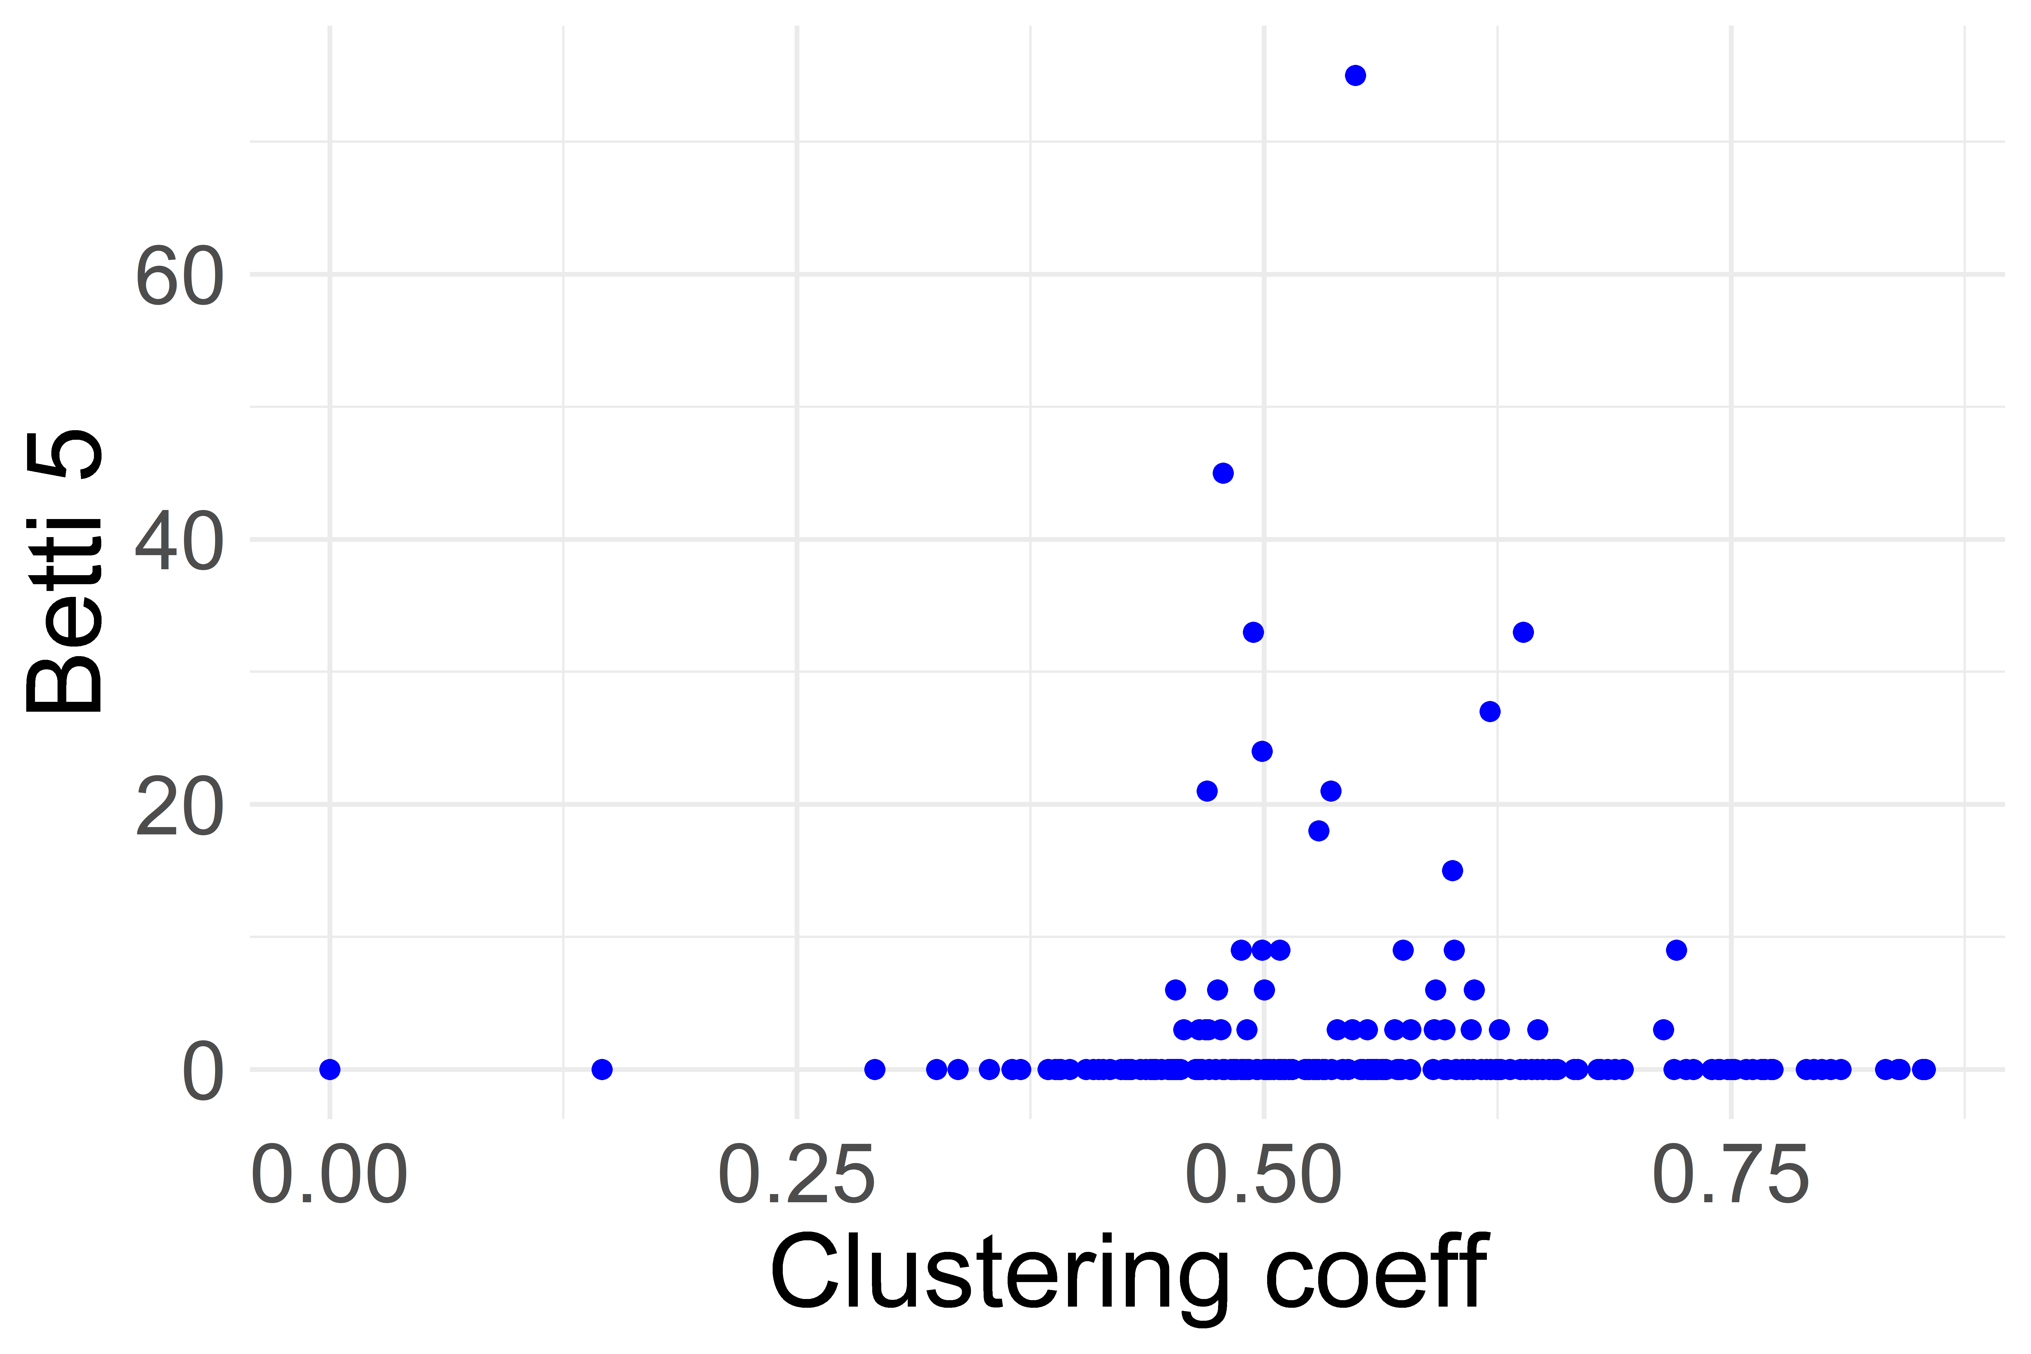
Higher Betti Numbers are Abundant in Large Networks
Clustering coefficients vs. number of topological features in TWITTER and FACEBOOK datasets.
Each blue dot represents a graph with hundreds of higher topological features

Slide 12
Cuneyt G. Akcora, Yulia R. Gel, Murat Kantarcioglu, Baris Coskunuzer
Cuneyt.Akcora@umanitoba.ca

